Slide 1
Bond Valuation
What is the Value of $1000 with an 8% coupon rate, 3 years before maturity? The YTM is 10%
Coupon = (.08) * $1000 = $80 T = 3 and YTM =0.10
Present Value =?
Answer$ 950.26

Slide 2
Problem2
The Palatin Paper Package (PPP) corporations $1000 bonds that pay a coupon rate of 8 percent in a single annual payment and mature in 20 years are selling for a current market price of $1050.
What does an investor in these bonds earn in terms of (a) Yield to maturity (YTM)
b) Current yields ( y)
c) Nominal yield or nominal interest rate (i)

Slide 3
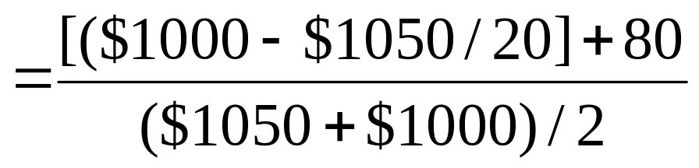
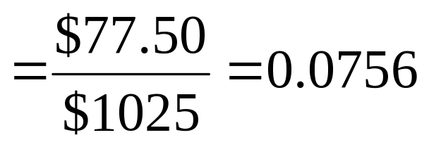
solution
The Approximate yield to maturity is given by

Slide 4
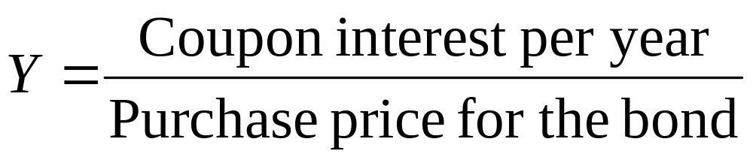
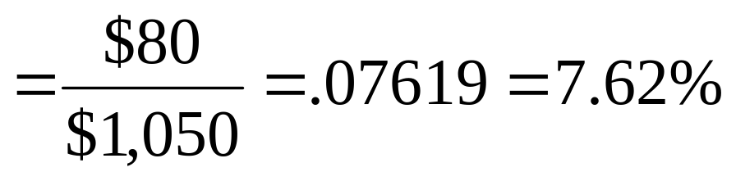
solution
The current yield ( y) from the PP bond is
c) The nominal interest rate is synonymous with the coupon interest rate, i=8.0 percent in this case.

Slide 5
Problem 3
a) Determine the price of a $1000 zero coupon bond with a YTM of 16% and 10 years until maturity.
b) What is the YTM of this bond if its price is $200?
Answer a) $226.68
        b) 17.46%

Slide 6
Semi Annual Coupon Payments
a) What is the value of a $1000 bond that is paying 3.5% annual coupon rate in annual payments over 10 years until it matures if its yield to maturity is YTM = 6.0%.
b) What is the bonds present value if the coupons are paid semiannually?

Slide 7
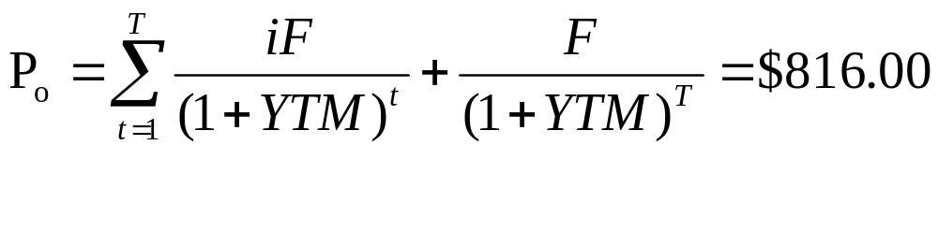
solution
a) We have YTM = 6.0%, i=3.5% and F=1000
Alternatively
P_{o}=iF( P/A, 6%,10) + F(P/F, 6%,10)

Slide 8
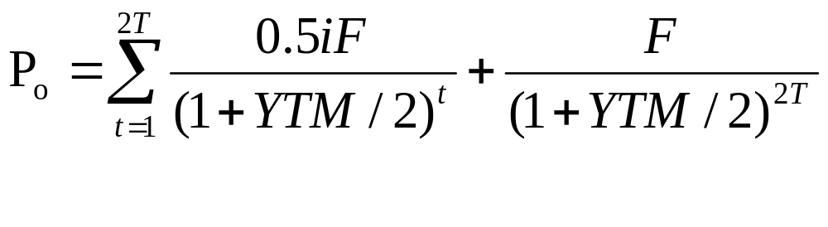
Solution
b) Converting annual compounding to the semiannual compounding model.
Answer = $814.032

Slide 9
Accrued Coupon Interest
Bond Buyers pay bond sellers accrued interest whenever a bond is purchased on a date that is not a scheduled coupon interest payment date. Thus if a bond were sold between its semiannual interest payment dates, the purchaser should pay the ,market price of the bond plus the appropriate fraction of the accrued coupon interest earned but not yet received by the party selling the bond.

Slide 10
Problem
What is the purchase price for a bond that is paying a 6% annual coupon rate in semiannual payments if its YTM =10.0% and it has 2 years and 10 months from its purchase date until its maturity? What is the accrued interest? Assume that the bond is traded in a year of 366 days when calculating the accrued interest.

Slide 11
solution
Since this bond has 2 months short of 3 full years until it matures
6
5
4
3
2
1
36 34
30
24
18
12
6
0
Purchase Date
Maturity Date

Slide 12
solution
1st step: Calculate its present value on the next interest payment date, which is 2.5 years until maturity.
Step 2:We will add the interest payment received on that date, to the price of the bond.
Step 3 The value determined in step 2 should be discounted back 4 months to the purchase date

Slide 13
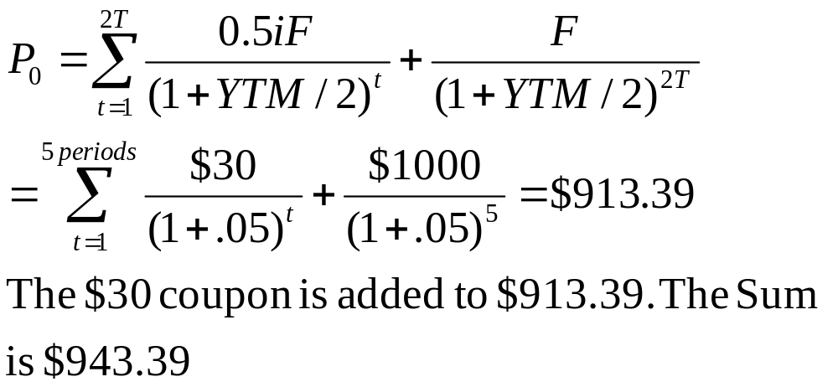
Solution

Slide 14
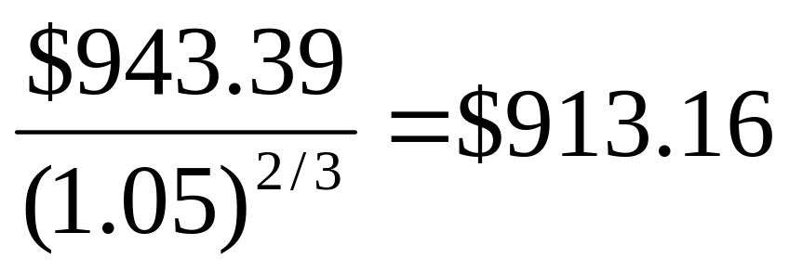
Solution
The value $943.39 is discounted back 4 months to the purchase date.
The bond’s price including accrued interest is $913.16

Slide 15
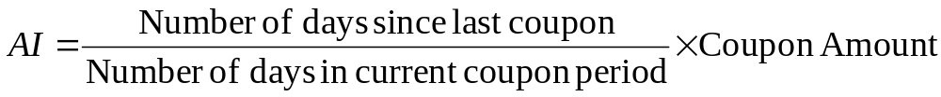
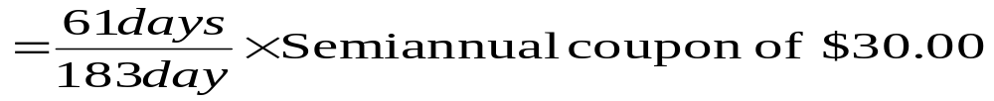
Solution
Calculate the accrued interest for 2 months:
Accrued Interest =

Slide 16
Yield to call
Sometimes the issuer of a bond the option to call( or redeem) the bond before it reaches maturity. This is likely to occur when the coupon interest rate on similar new bonds is substantially below the coupon interest on existing bonds because the corporation can save money on future interest payments. When a bond has an excellent chance of being called, an investor may want to calculate the yield to call for the bond. This can be accomplished by modifying the basic bond equation in the following manner. T would now equal the number of periods until the bond is called and face value would now be the call value.

Slide 17
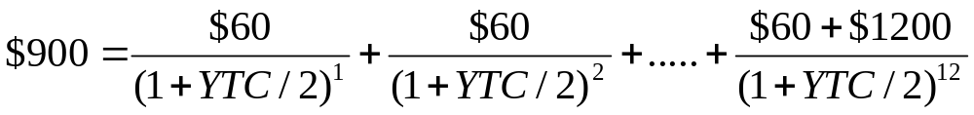
Problem
The oak Grove Corporaton has a 12% semiannual bond issue with F =$1000 that matures in 15 years but it is called in six years at $1200. If the current price of the bond is $900, determine its yield to call ( YTC).
The coupon is equal to 0.5*0.12*$1000 = $60
Solving by trial and error, the exact answer is 16.77.

Slide 18
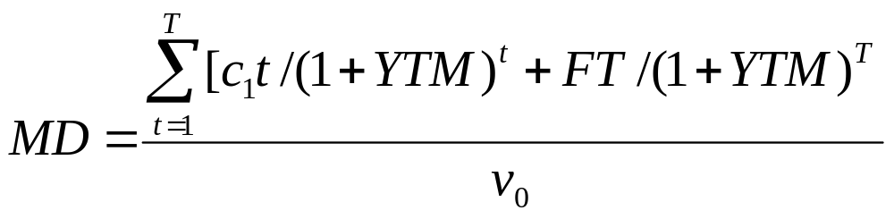
Bond Duration
Macaulay’s duration is the average time it takes to receive the cash flows expected from a bond or another asset.
c_{t} is the coupon to be received at time t
F is the face value of the bond
v_{o} is the present value the bond

Slide 19
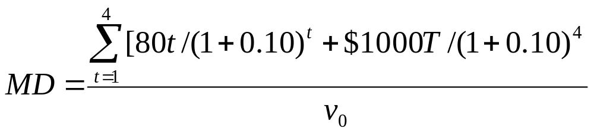
Problem
Determine Macaulay’s duration of a bond that has a face value of $1000, an 8% annual coupon rate and 4 years until maturity.The bonds YTM is 10%.
What is the modified duration for this bond

Slide 20
solution
The Value of v₀ is
(1) Year,t | (2) Cash Flow | (3) 1/(1+YTM)^{t} | (4) (2) X (3)
1 | $80 | .9091 | $72.73
2 | $80 | .8264 | 66.11
3 | $80 | .7513 | 60.10
4 | $80+$1000 | .6830 | 737.64
 |  | v₀ | $936.58

Slide 21
solution
(1) Year,t | (2) Present Value | (3) Present value as proportion of V_{o} | (4) (3) X (1)
1 | $72.73 | 0.0777 | 0.0777
2 | 66.11 | 0.0706 | 0.1412
3 | 60.10 | 0.0642 | 0.1926
4 | 737.64 | 0.7876 | 3.1504
 | $936.58 | 1.0 | Duration= 3.5619

Slide 22
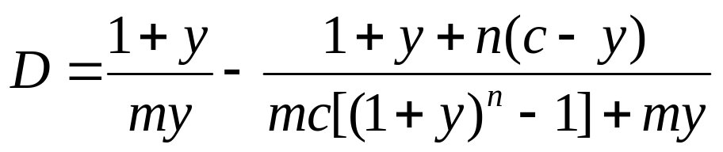
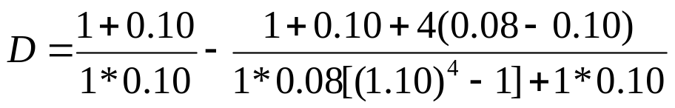
solution
Alternate formula
The value of D is 3.5616

Slide 23
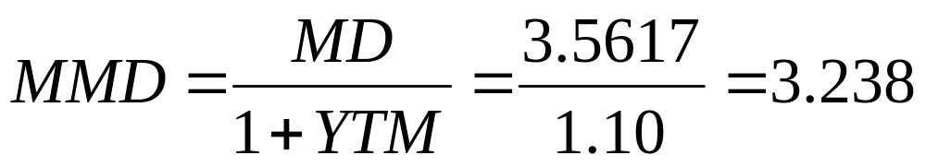
solution
b) The modified duration for this bond is

Slide 24
Problem
The oak Grove Corporaton has a 12% semiannual bond issue with F =$1000 that matures in 15 years but it is called in six years at $1200. If the current price of the bond is $900, determine its yield to call ( YTC).
If the YTM for the bond goes from 10% to 11% determine the new price for the bond with the modified duration equation.

Slide 25
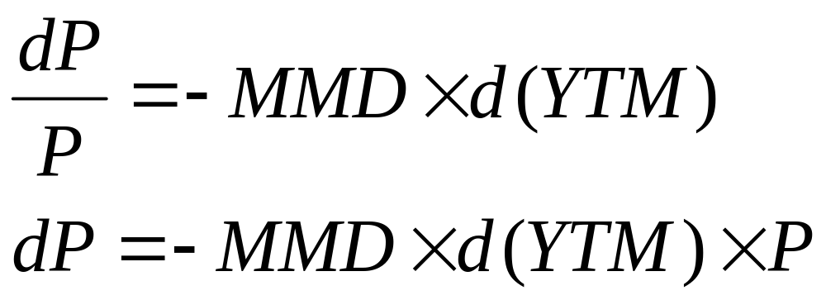
solution
Modified duration was determined to be 3.238 and v_{o}(bonds current price) was calculated as $936.58
dP = -MMD x .01 x $936.58= -30.33
The new price is 936.58- 30.33 = $906.25
This is a linear approximation to a curvilinear function.The actual price turns out to be $906.93 if the present value is used.

Slide 26
Problem
The Jones company recently issued a $1000 12 percent semiannual bond with 20 years to maturity.
a) What will be the price of the bond if the market rate of interest is 14 percent?
b) Determine the bond’s Macaulay’s duration when it was issued c) 2 years later.

Slide 27
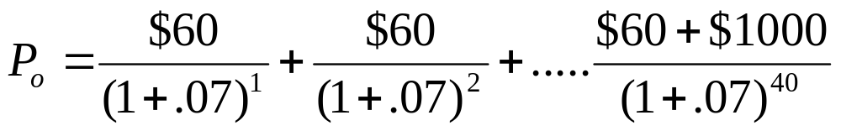
solution
The bond’s price can be calculated with
Alternatively
P_{o} = $60(P/A,7%,40) + $1000(P/F,7%,40)

Slide 28

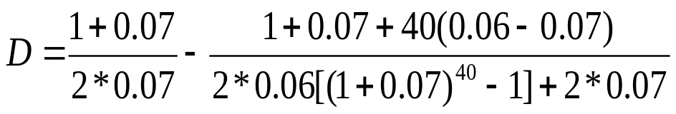
solution
b) Macaulay’s Duration when it was issued
The Value of D is 7.274 years

Slide 29

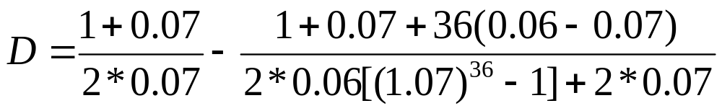
Solution
Two years after issue the duration is
The Value of D is 7.132 years

Slide 30
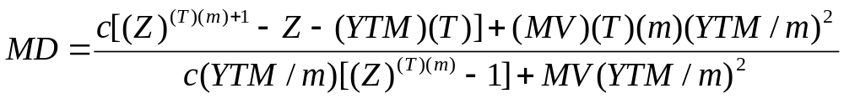
Problem
Mr. Ed Smith will be making a car payment of $316 per month for the next 4 years. If the rate of interest on Ed’s loan is 1 percent per month, what is the duration of the loan
In eq m = number of compounding periods in a year, Z = (1+YTM/m).
MD = Macaulay’s Duration T = number of years until maturity. MV = maturity( or face) Value

Slide 31
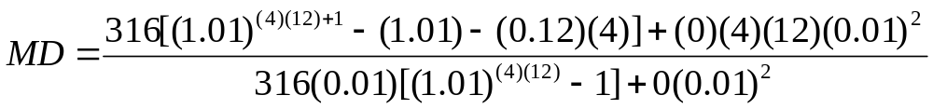
Solution
In this situation, YTM =(.01 * 12)=0.12
C= 316, T =4, MV =0
MD= 22.596 Months

